Slide 1
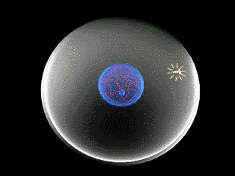
Mitosis
AEHBY Human Biology
This Photo by Unknown Author is licensed under CC BY-NC-ND

Slide 2
Review
List the four phases of the cell cycle. (4 marks)
Describe the differences between a gene and a chromosome. (2 marks)
Give one example of an epigenetic transcription promotor and one example of an epigenetic transcription inhibitor. (2 marks)
Name a bone and give its location for each of these shapes (10 marks):
a) flat b) long c) sesamoid d) irregular e) short

Slide 3
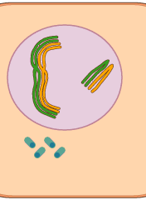
Learning Intentions
The sequence of DNA replication, chromosome duplication and chromosome separation are important processes in the production of identical daughter cells by mitosis for growth, repair and replacement of tissues within the body.
This Photo by Unknown Author is licensed under CC BY-SA-NC

Slide 4
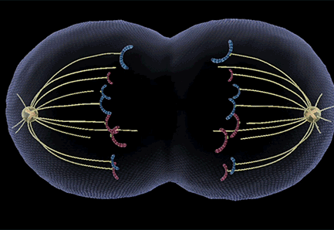
Success criteria
List the key structures involves in mitosis.
Describe the main processes in each phase of mitosis.
Define cytokinesis.
Compare the number of chromosomes in the parent and daughter cells.

Slide 5
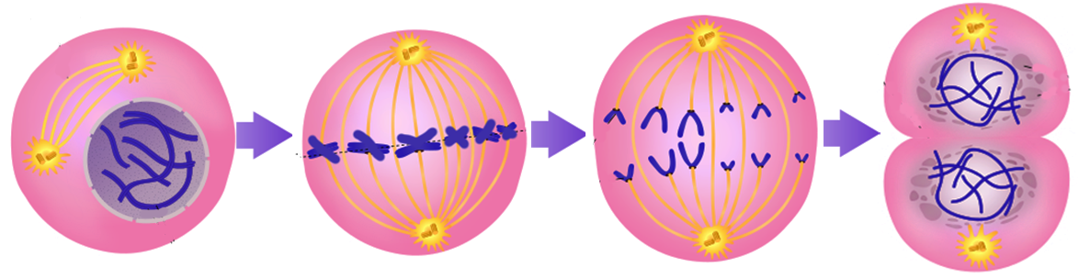
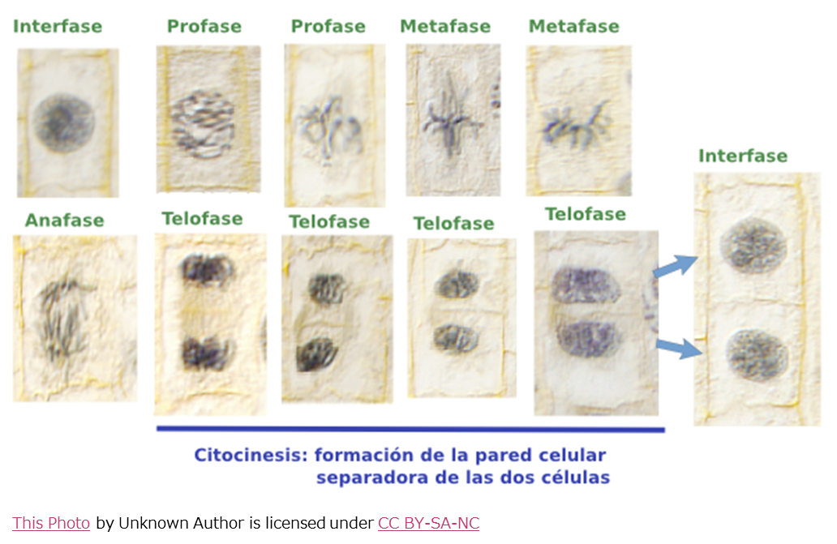
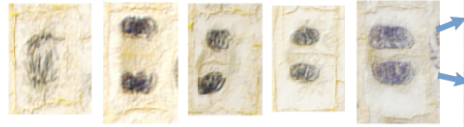
Mitosis
Mitosis ensures that each cell receives the exact same genetic material as its parent cell.

Slide 6
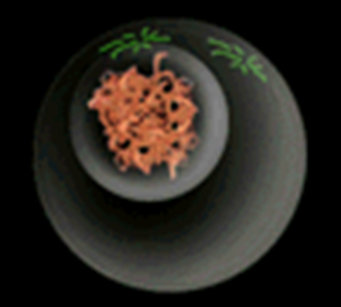
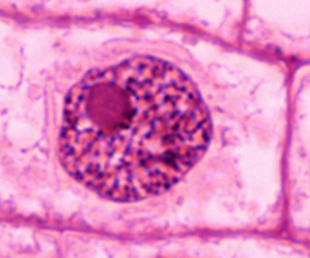
Interphase
The period between nuclear divisions, during which the DNA molecules replicate, making exact copies of themselves.
(consists of G1, S and G2 phases)

Slide 7
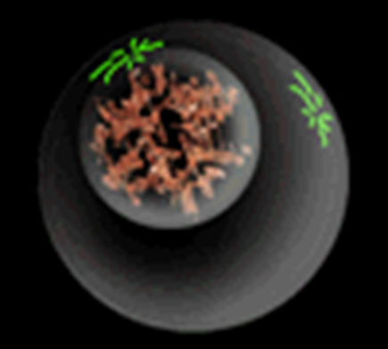
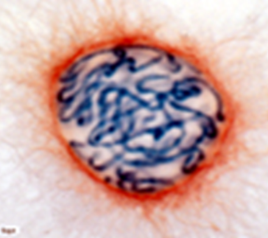
Prophase
Two pairs of centrioles become visible and move towards opposite ends (poles) of the cell, microtubules begin to radiate from each of them (these will become spindle fibres).
The nucleolus disappears and the nuclear membrane breaks down.
Chromatin threads of DNA coil into visible chromosomes.

Slide 8
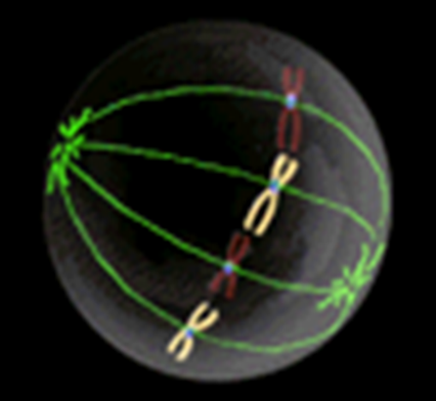
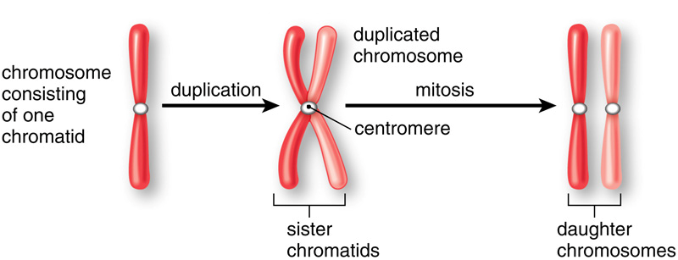
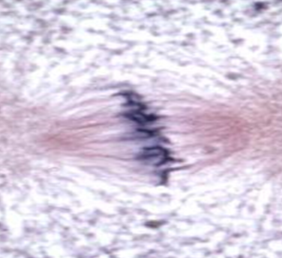
Metaphase
Chromosomes line up along the equator of the cell, each centromere attaching to a spindle fibre.

Slide 9
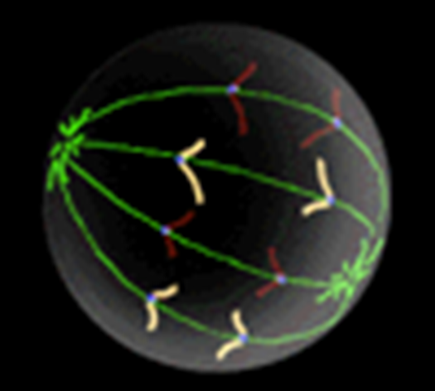
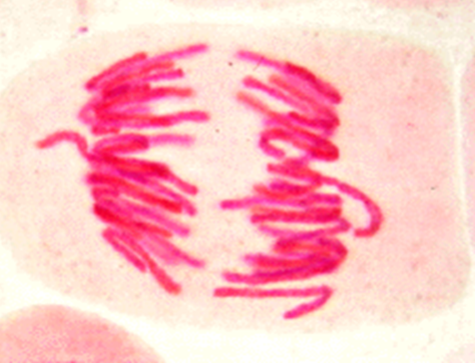
Anaphase
Each chromosome separates into two chromatids, which are pulled apart towards each end of the cell by the contracting spindle fibres.
Once apart, the chromatids are now once again referred to as chromosomes.

Slide 10
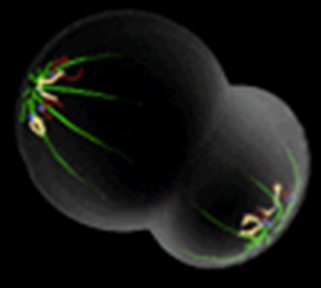
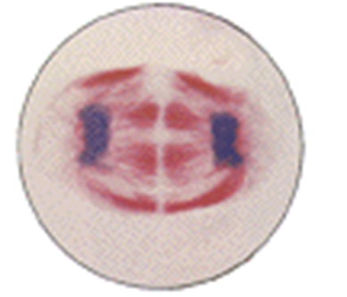
Telophase
Two sets of chromosomes cluster at each pole of the cell.
The nuclear membrane reforms around each new nucleus and the spindle fibres dissolve.
Gradually the chromosomes uncoil to become chromatin threads.

Slide 12
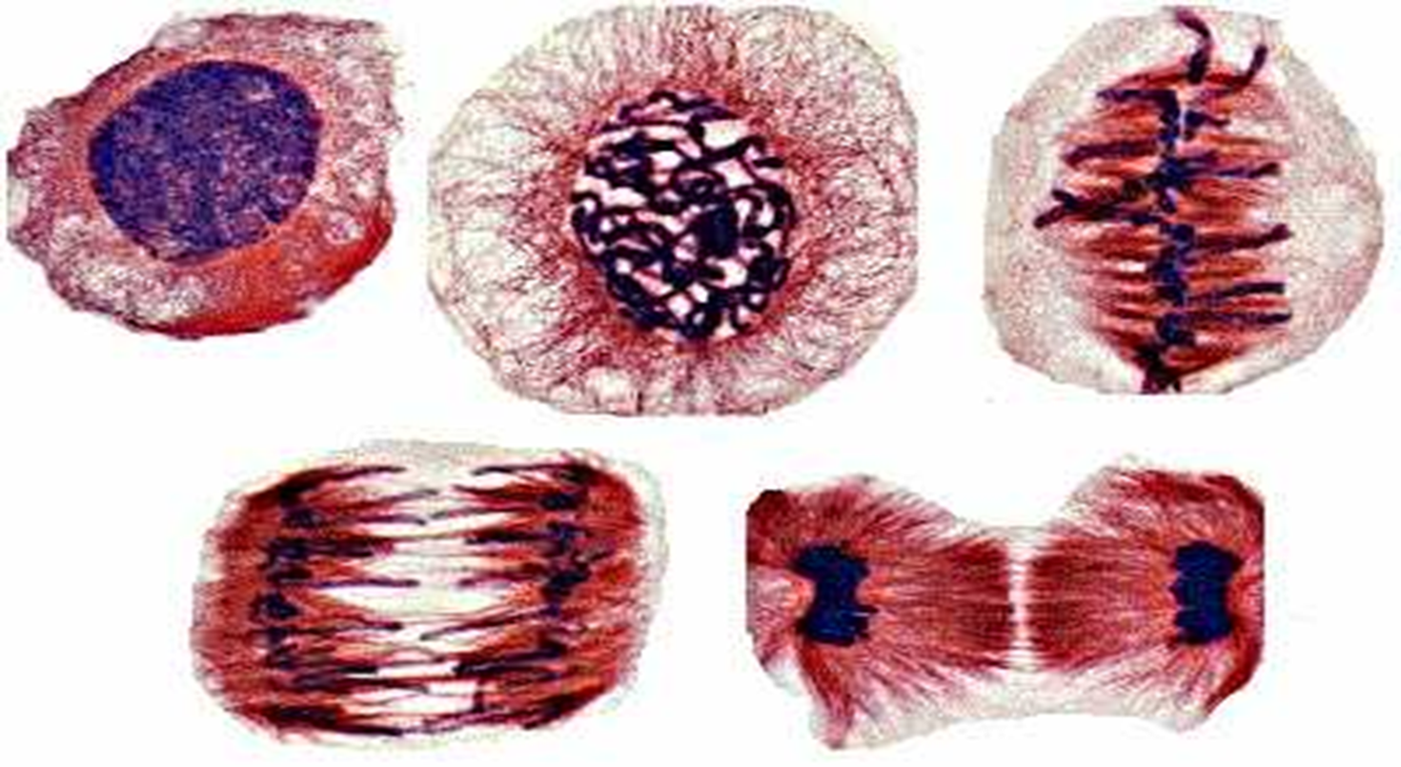
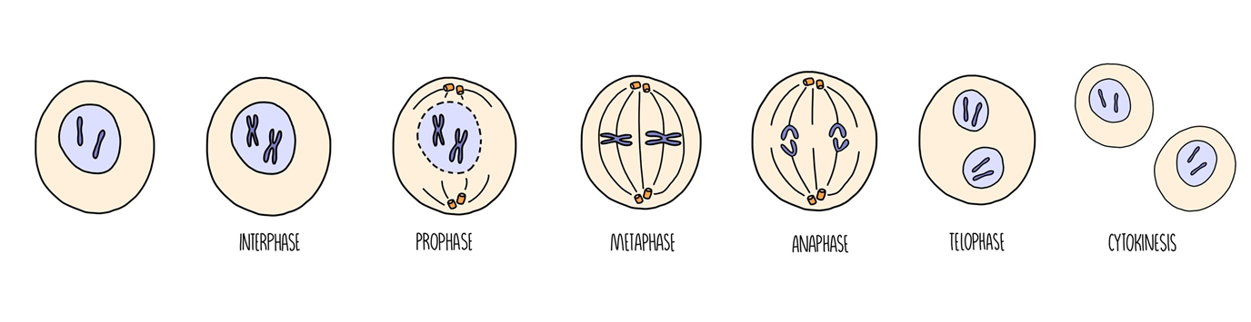

Slide 13
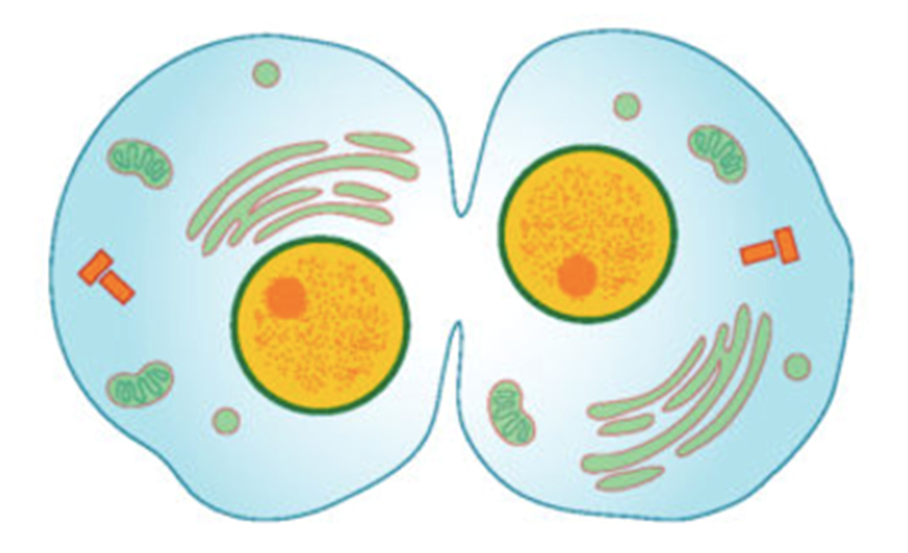
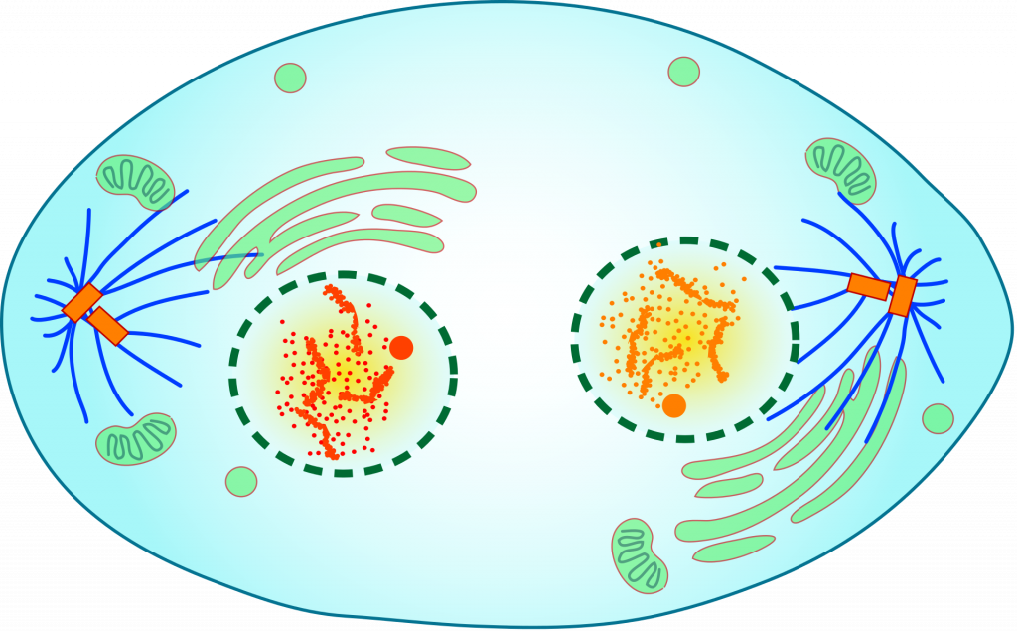
Cytokinesis
Essentially, mitosis is the process of replicating and dividing the nucleus, but the cytoplasm and cell membrane also need to be divided into the two new cells.
After telophase, cytokinesis divides the cytoplasm by pulling the cell membrane inwards at the equator until the cell is split into two separate cells, each with its own nucleus and organelles.

Slide 14
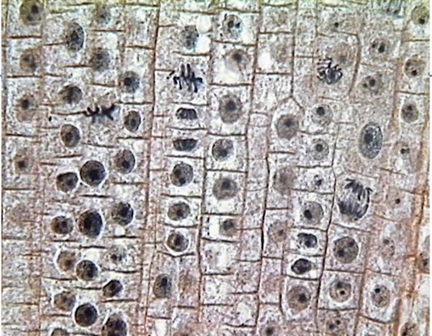

Slide 15
Success criteria
List the key structures involves in mitosis.
Describe the main processes in each phase of mitosis.
Define cytokinesis.
Compare the number of chromosomes in the parent and daughter cells.

